Slide 1
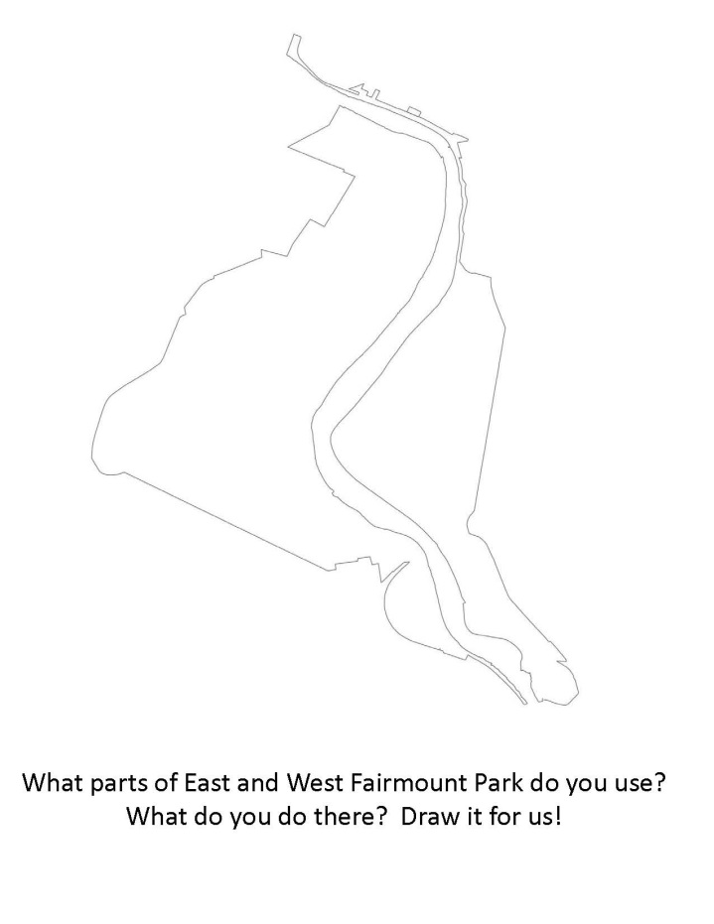




A Community Vision and Action Plan for East and West Fairmount Park
Thank you for coming!
Please take a moment to fill in your “map” handout of where and how you use the park!

Slide 2
Philadelphia Parks and Recreation
Fairmount Park Conservancy
PennPraxis
Penn Project for Civic Engagement
What improvements, uses, activities will make East and West Fairmount Park a more enjoyable public space for its communities?
How can this 160-year old park better serve its residents in the 21st century?
our team and goals
Notes:
Philadelphia Parks and Recreation
Fairmount Park Conservancy
PennPraxis: afilliated with Penn but do all our work in the community. Always geared around public spaces and large outreach to members of the public. Design excellence for community-based projects.
Penn Project for Civic Engagement: organizes public conversations on important issues, helps devise solutions for tough problems.
Funded by William Penn Foundation
How can we make the park (1) easier to access, and (2) more enjoyable for Philadelphia residents? If you start by planning for residents, the rest falls into place.
This vision for a restored park will be based on public input and guide the City for years to come.
Input will be the base of recommendations.

Slide 3
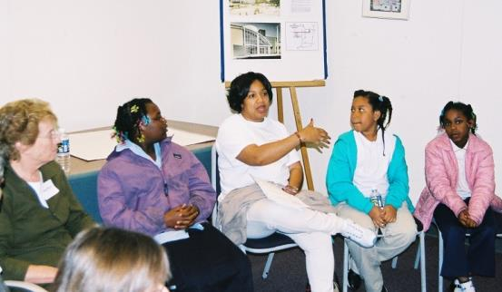
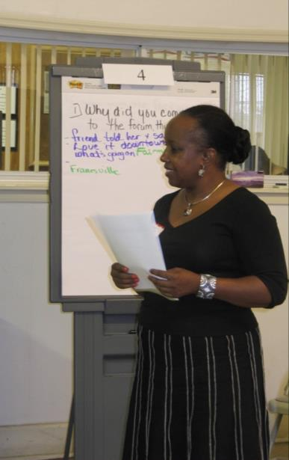
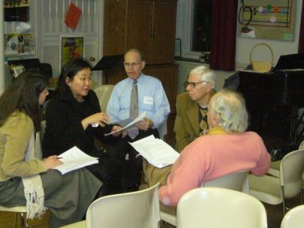
our process
Notes:
EMPHASIZE ROLE OF THE PUBLIC AND FEEDING OUR RECOMMENDATIONS
If park cannot serve its most adjacent neighbors, then it’s not doing its job. That is really important for us to know.
Learning/Fact Finding
Talking to People
a. Park Officials/Organizations
b. Community Leaders
c. Residents
d. YIELD: draft guidelines for improving East and West Park
Identify Most Important Areas
Recommendations (based on GUIDELINES)
Final Report and Presentation

Slide 4
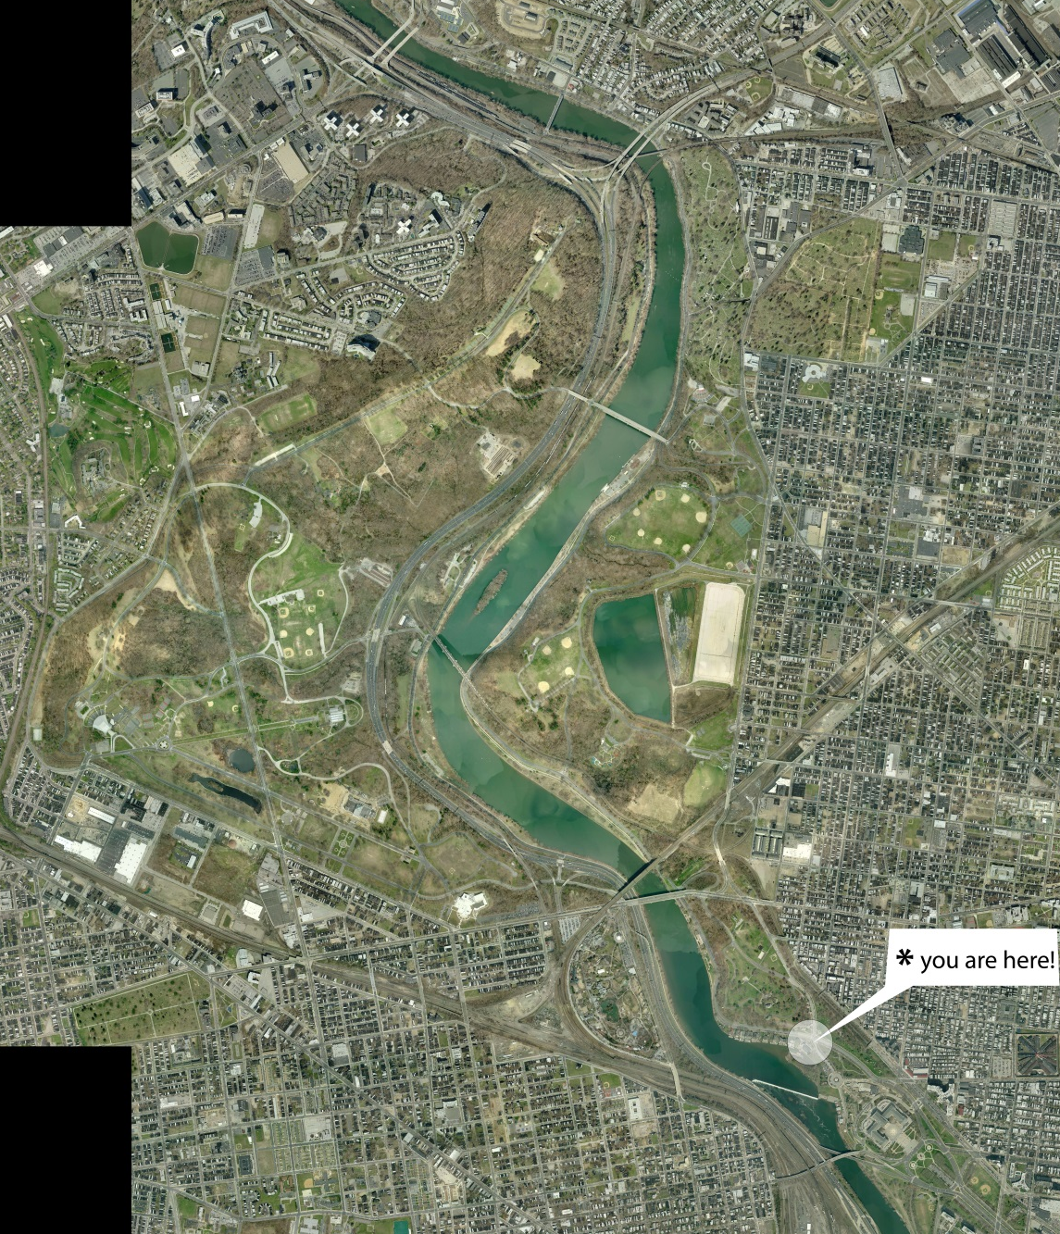
East and West Fairmount Park
Notes:
Here we are! Note big systems and context.
2000 acres, 2400 with river
I-76, Kelly Drive, King Drive, 33rd Street, Parkside Avenue, Belmont Avenue

Slide 5
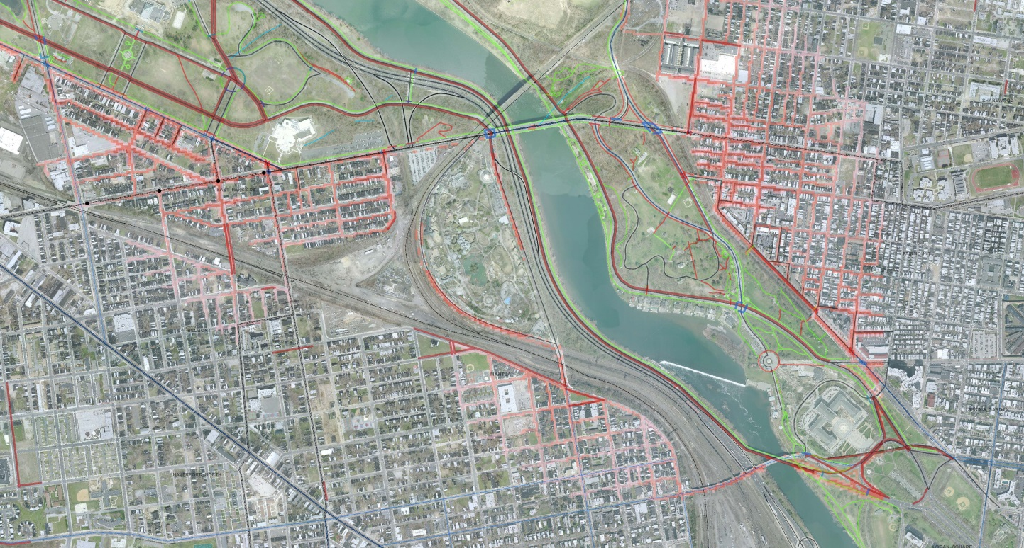
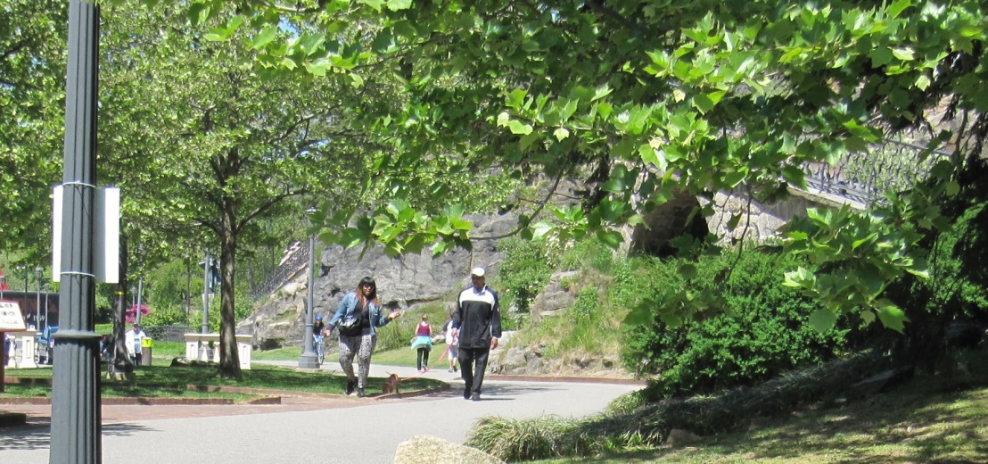
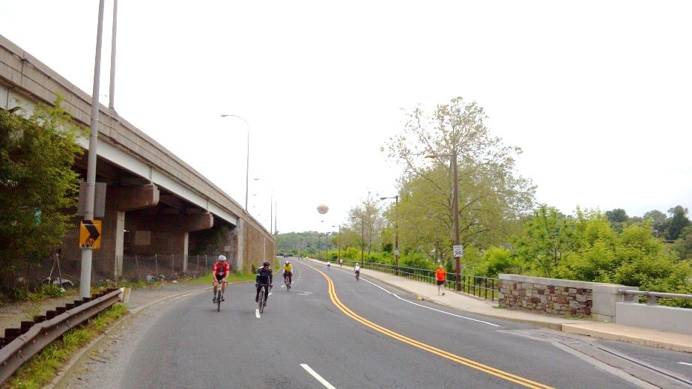
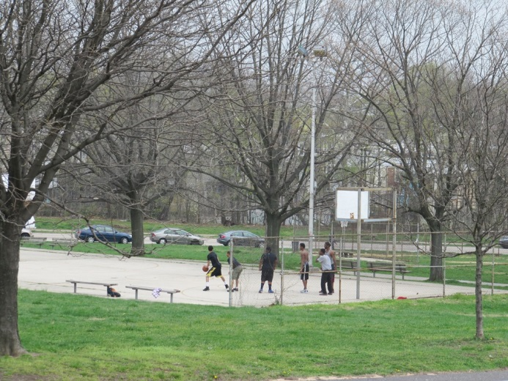
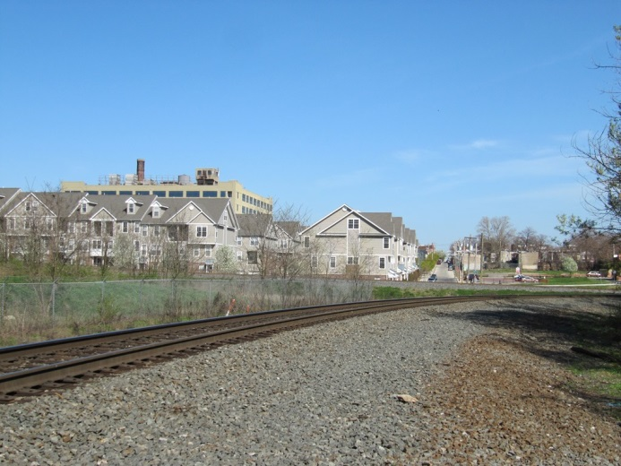
what’s your park?
Notes:
Zoom in on portion of the park we’re near.
Take time to orient the crowd.
NOTES
Walking distance – because of a few intersections and relatively small size of the park here, many east side neighbors can access the park and river relatively easily. However, what do those connections look like, and what do they do when they want to access the rest of what the park has to offer, in terms of across the river or further north into East Park? Neighborhoods get increasingly cut off and frayed connections as you move north.
Photos – trail from Schuylkill Banks behind Art Museum to Kelly Drive; Lemon Hill Playground – historic site, picnic area, neighborhood park; MLK Drive weekend recreation closure in terms of connections to the west side; numerous neighborhoods that are cut off, including Brewerytown at Thompson Street behind Glendinning Rock Garden

Slide 6
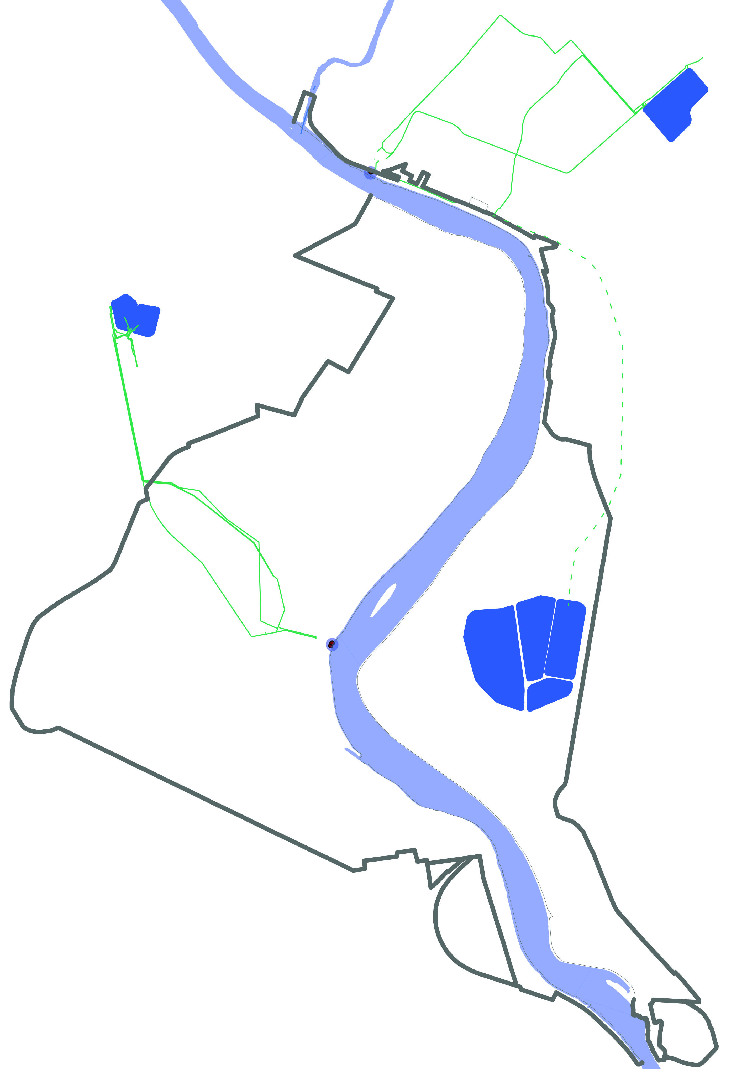
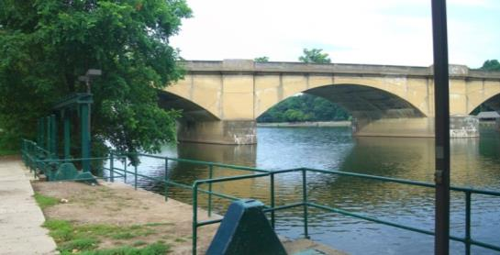
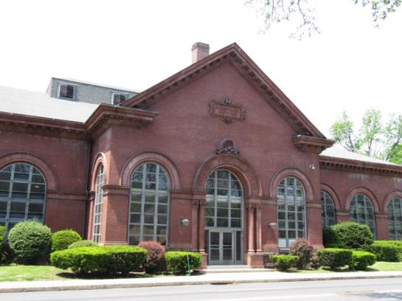
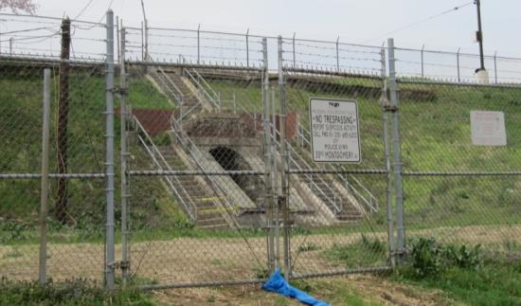
our park is: our drinking water source.
Notes:
You can safely say that at least two thirds of Philadelphians get AT LEAST PART of their drinking water from this portion of the park. We don’t have exact numbers, but essentially:
All of West Philadelphia
Everything west of Broad Street
Portions east of Broad Street get a mix
That photo is where all of West Philadelphia’s water comes from!

Slide 7
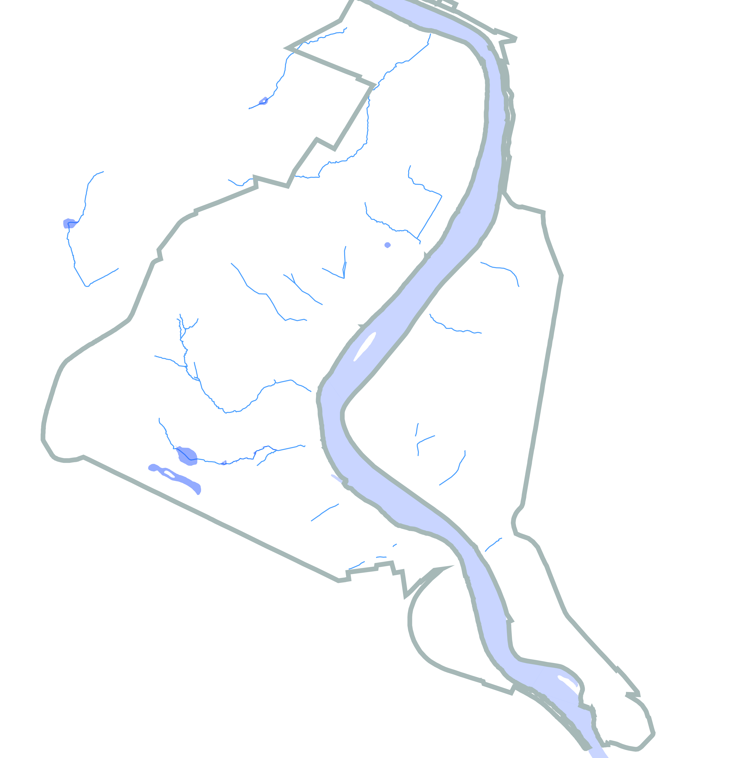
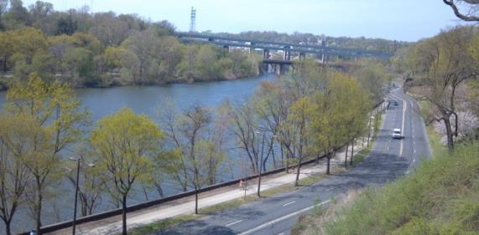
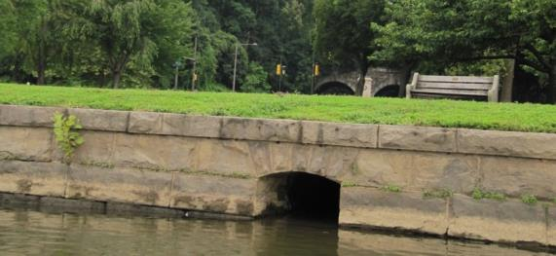
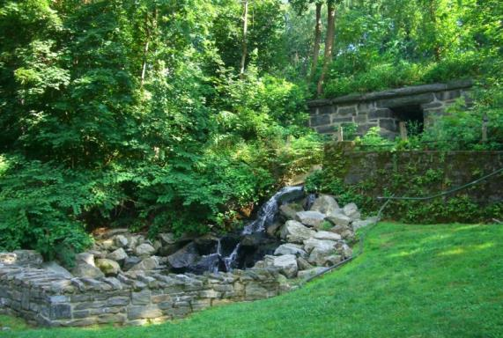
our park is: many watersheds.
Notes:
10.8 miles of water, 3.8 miles is the Schuylkill River.
15 creeks

Slide 8
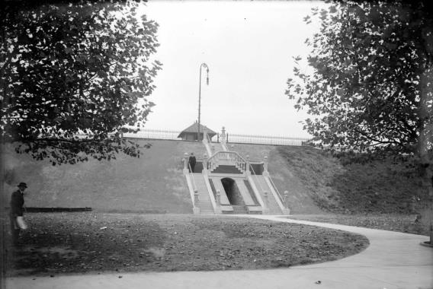
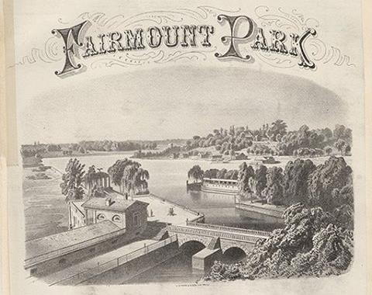
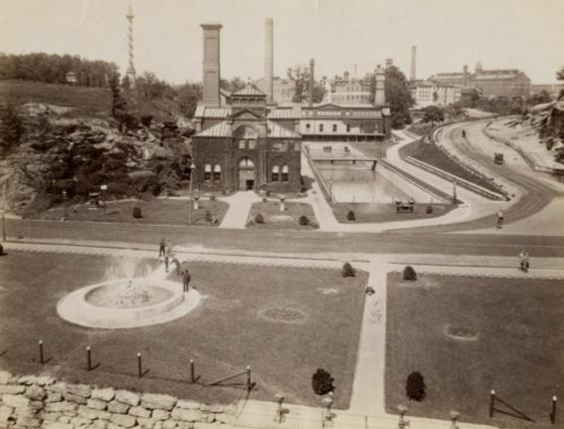
our park is: water + public space.
Notes:
Celebration of this unique pairing of public water and public space

Slide 9
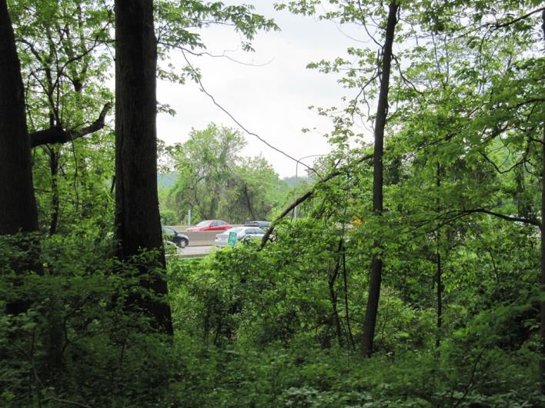
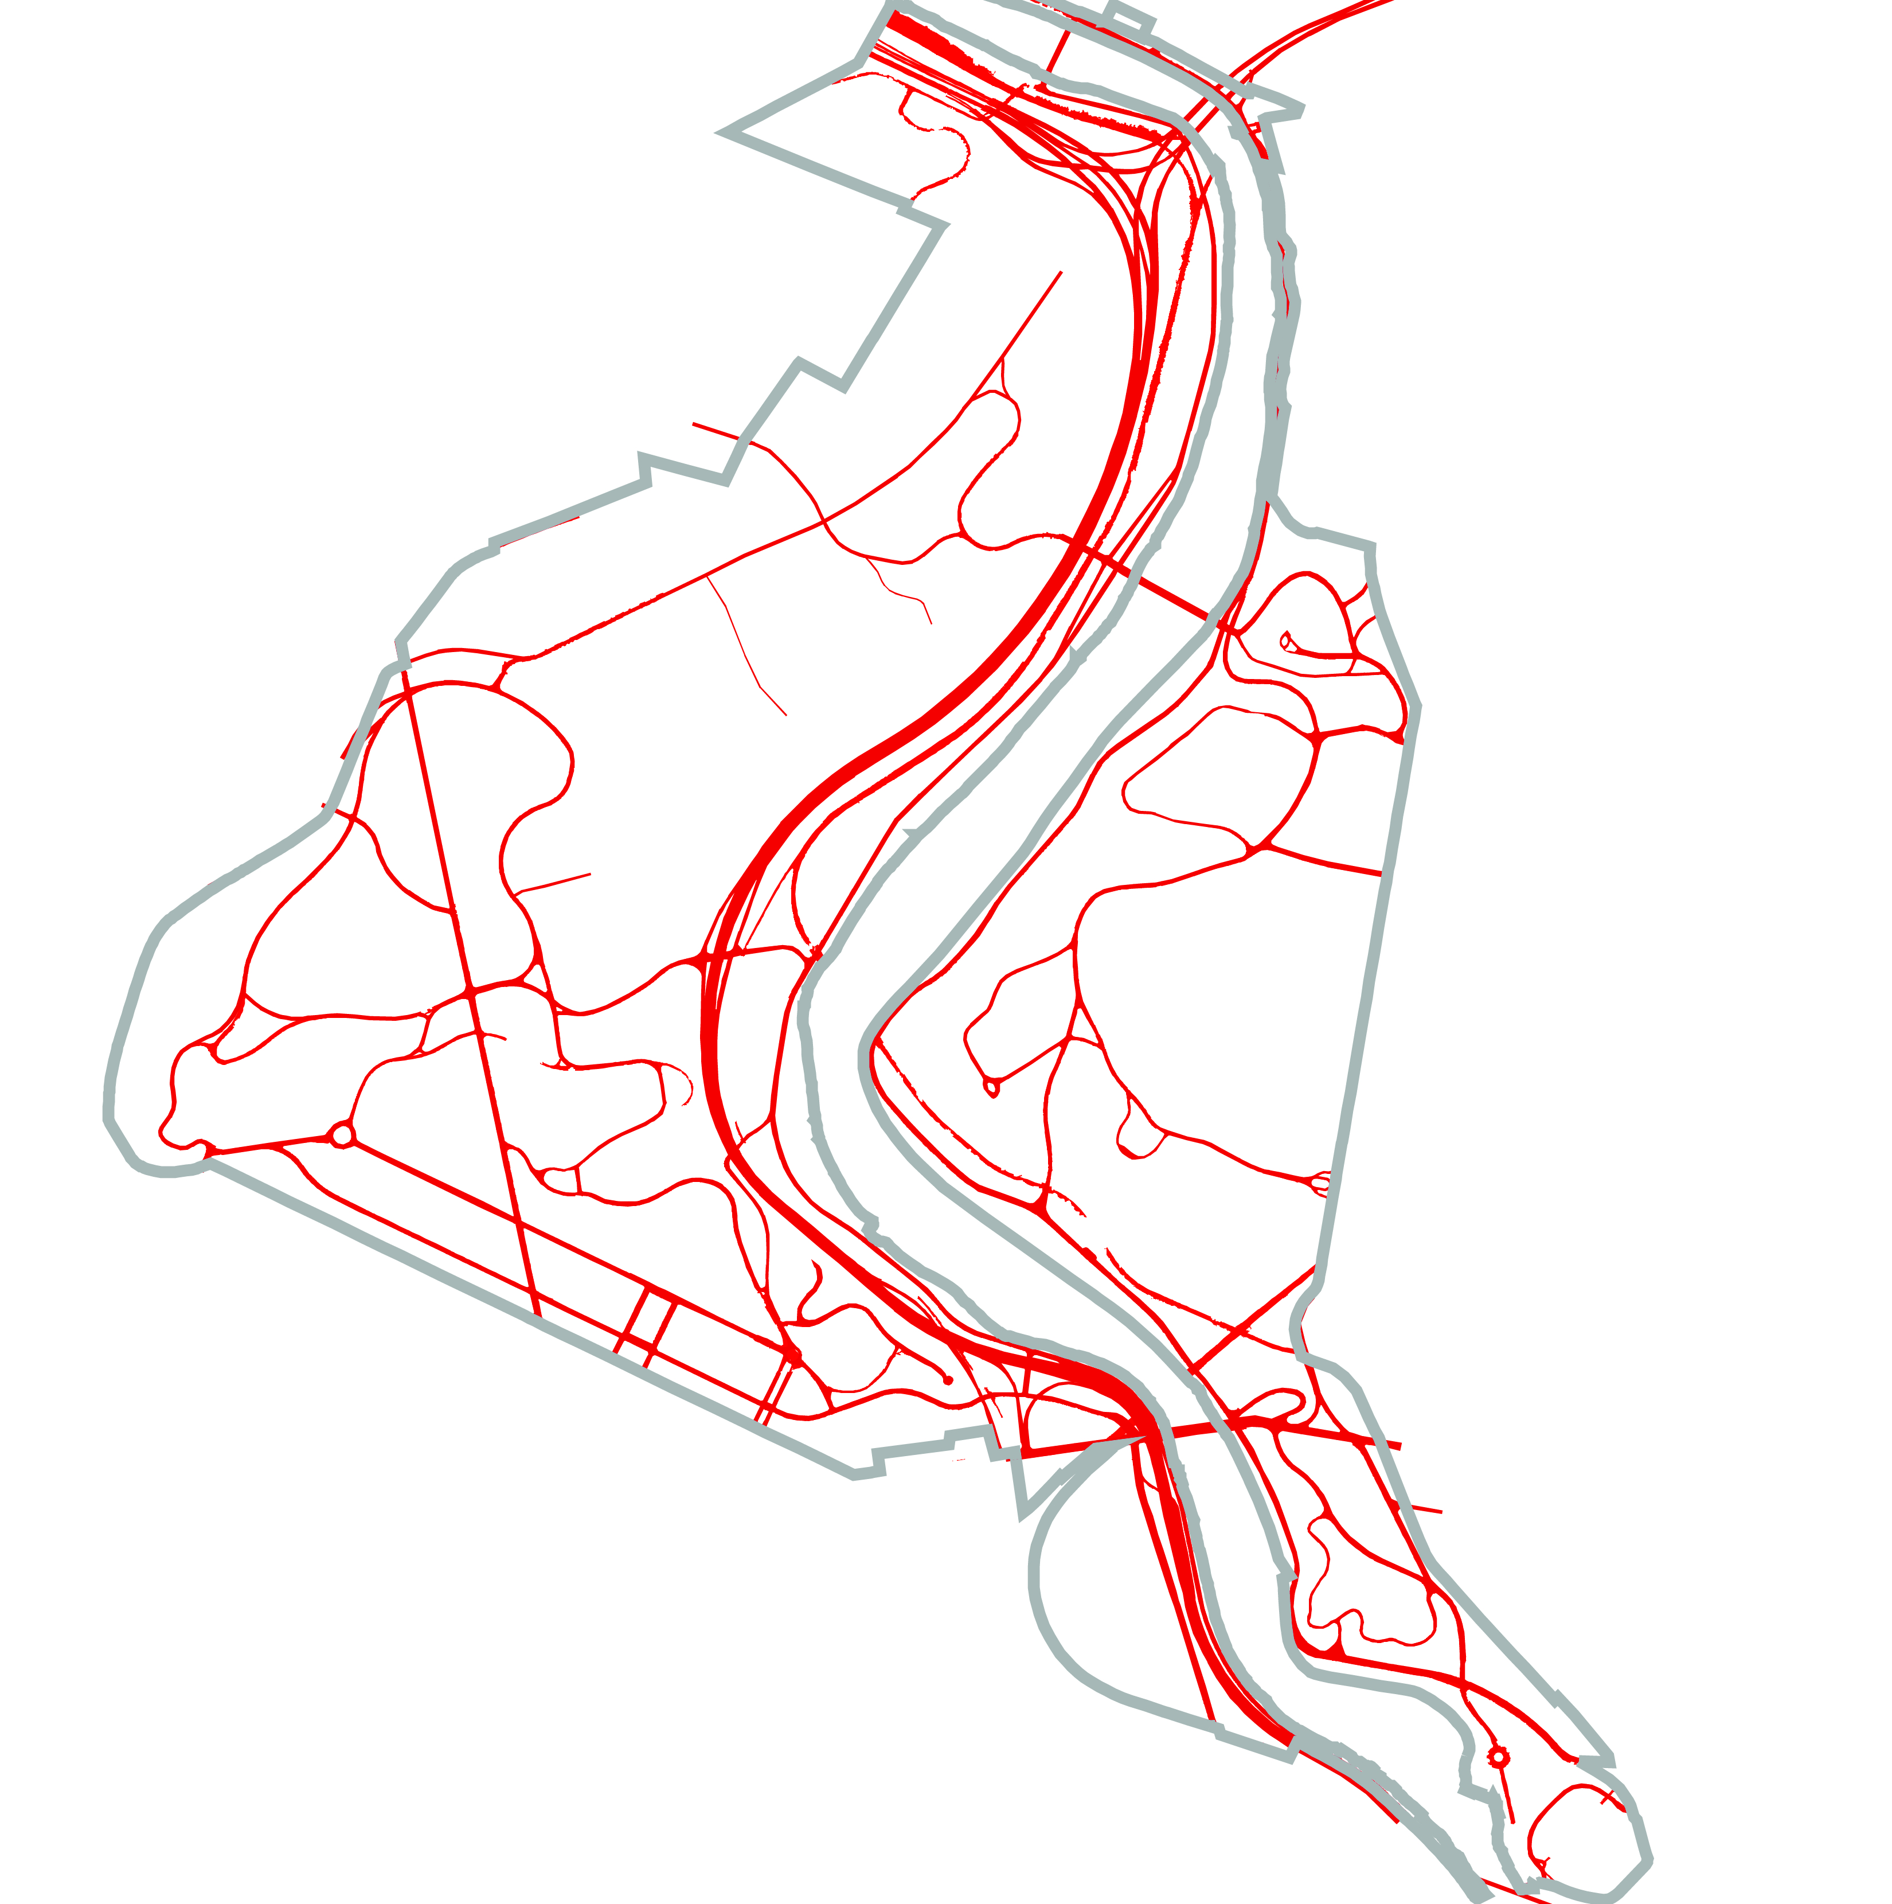
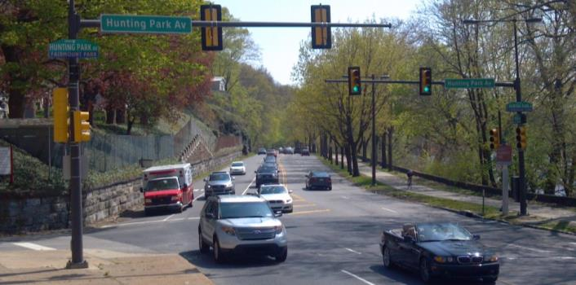
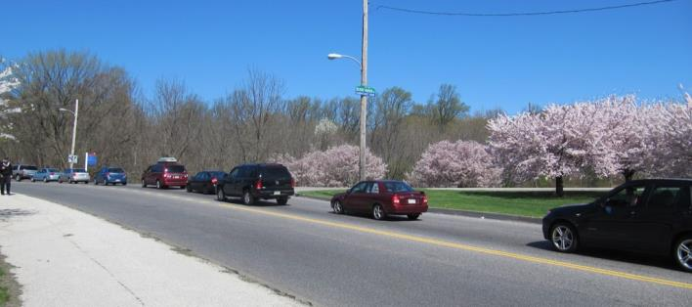
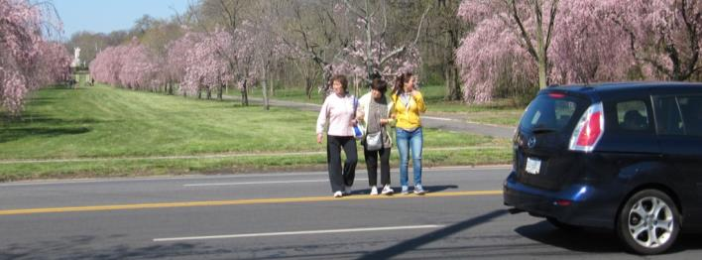
our park is: heavily travelled.
Notes:
Examples:
I-76: 124,000 cars per day
Belmont: 26,000
Kelly: 28,000
Girard: 24,000
Ridge: 20,000
MLK: 13,000
Translation: TONS OF CARS!

Slide 10
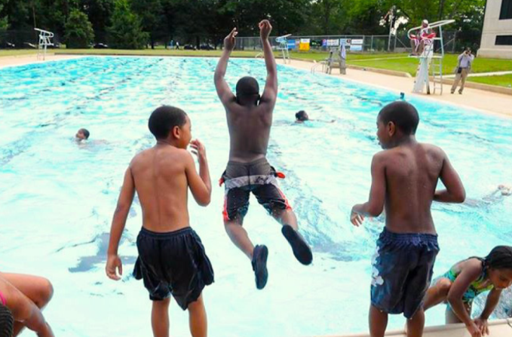
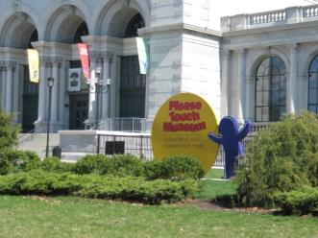
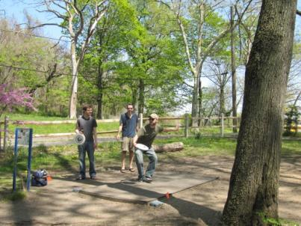
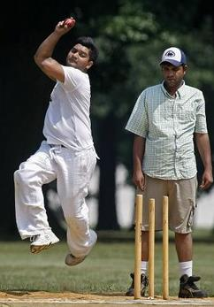
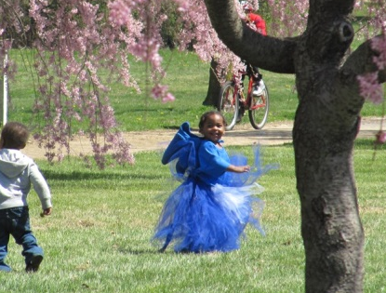
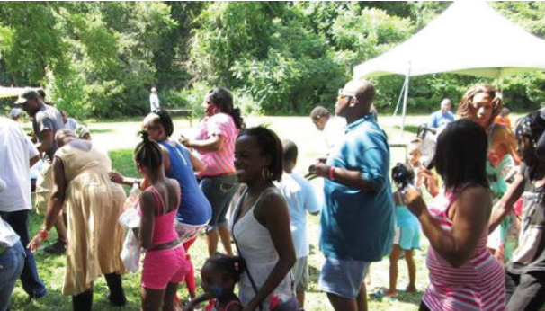
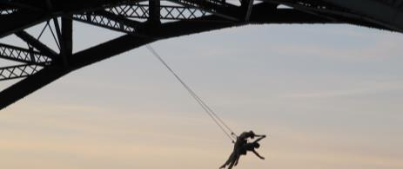
our the park is: limitless activity!

Slide 11
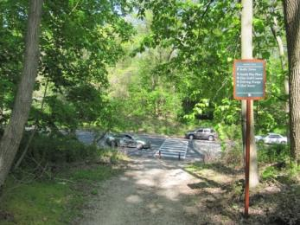
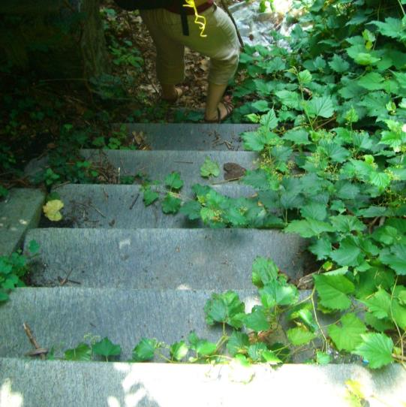
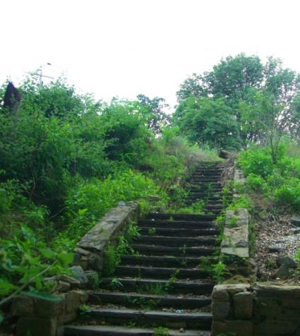
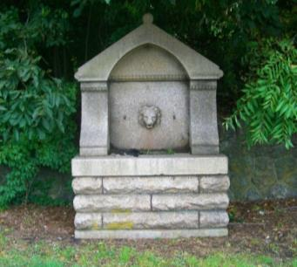
Fairmount Park needs to better serve its adjacent neighborhoods. Without that, it cannot thrive.
This means all residents: make sure the park is safe for all to use and has activities for all ages and walks of life.
Find large and small ways to improve walking access into the park. This includes learning from improvements made to the park over 160 years ago, including stairs, trails along creeks, bridges over ravines, and cliff walks.
We cannot just connect people to the edges of the park, but also connect people to all the activities going on throughout the park.
Start by improving how people enter and access the entire park.
draft guideline #1
Notes:
Fairmount Park needs to better serve its adjacent neighborhoods. Without that, it cannot thrive.
This means all residents: make sure the park is safe for all to use and has activities for all ages and walks of life.
Find large and small ways to improve walking access into the park. This includes learning from improvements made to the park over 160 years ago, including stairs, trails along creeks, bridges over ravines, and cliff walks.
We cannot just connect people to the edges of the park, but also connect people to all the activities going on throughout the park.

Slide 12
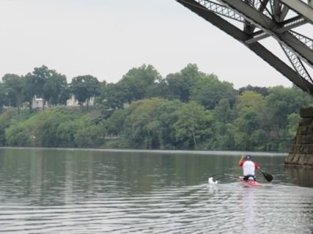
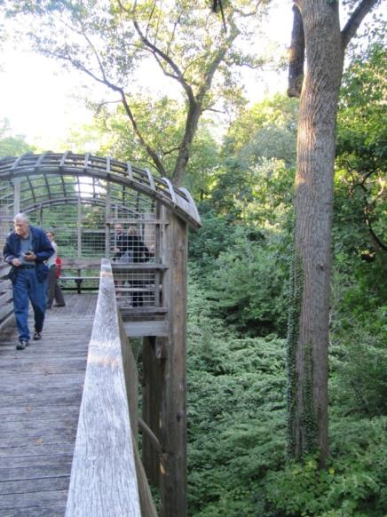
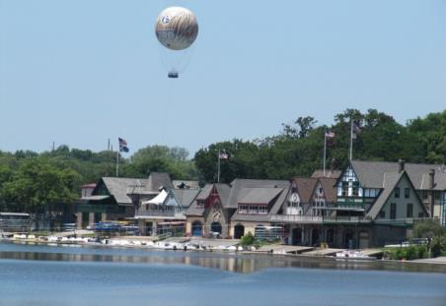
Protect all that we already have in Fairmount Park, both natural and man-made.
Make it easier for citizens to enjoy nature in Fairmount Park
Do not build anything without considering what impact it has on nature and wildlife
Create ways for people to enjoy the water, but not overpower it
Preserve all those who currently help make the park a better place for all Philadelphians today
Find a better way to teach people about the history of the park and attract people to its historic structures
Protect and enhance all that we already have in Fairmount Park, both natural and man-made.
draft guideline #2
Notes:
Make it easier for citizens to enjoy nature in Fairmount Park
Do not build anything without considering what impact it has on nature and wildlife
Create ways for people to enjoy the water, but not overpower it
Preserve all those who currently help make the park a better place for all Philadelphians today
Find a better way to teach people about the history of the park and attract people to its historic structures

Slide 13
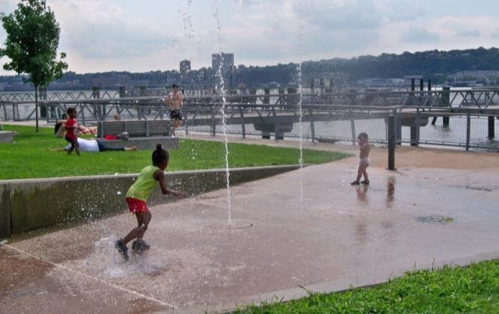
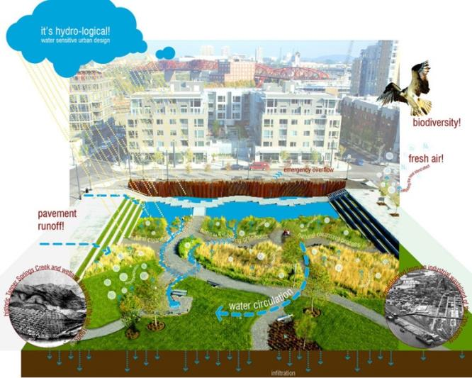
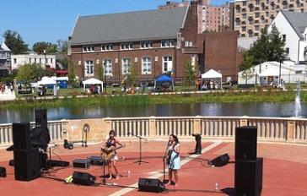
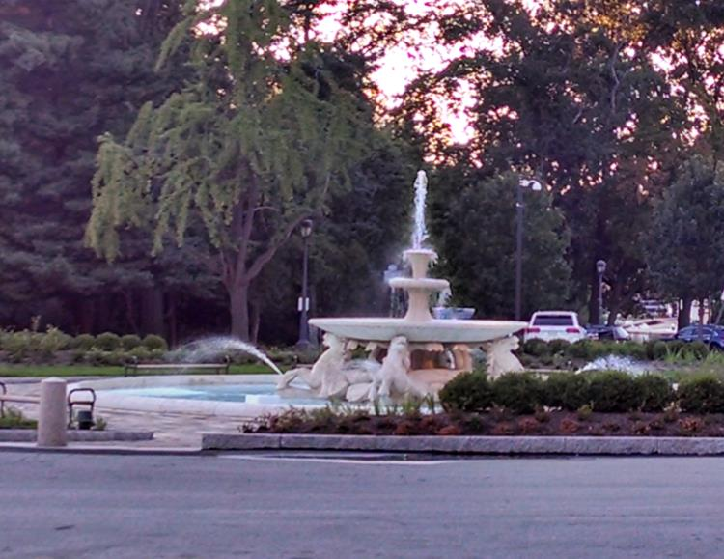
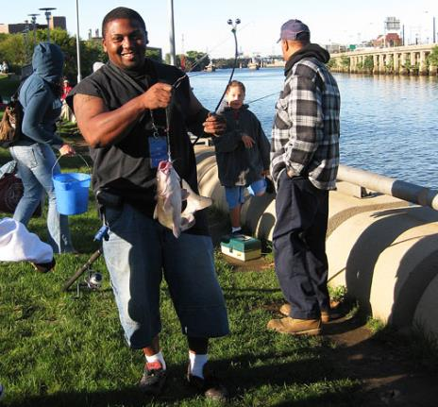
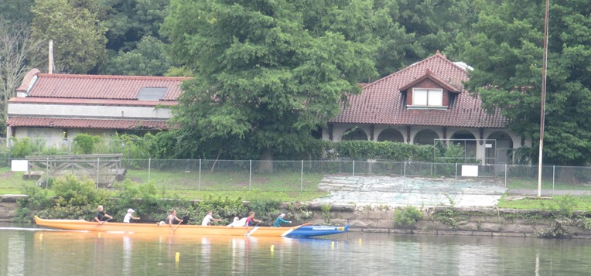
Allow people to better enjoy the water.
Build trails along old creeks that take people throughout the park
Create new water recreation activities in the Schuylkill River and throughout the park
Do a better job of showing how Fairmount Park makes our drinking water cleaner
draft guideline #3
Notes:
Build trails along old creeks that take people throughout the park
Create new water recreation activities in the Schuylkill River and throughout the park
Do a better job of showing how Fairmount Park makes our drinking water cleaner

Slide 14
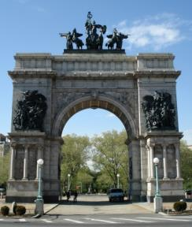
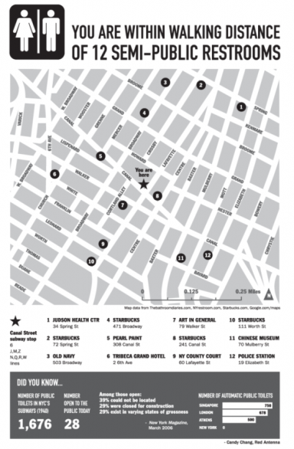
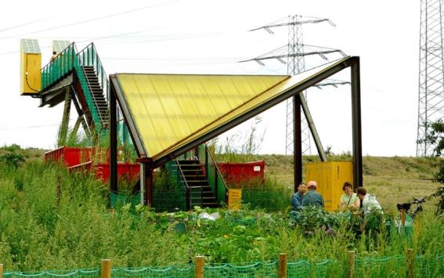
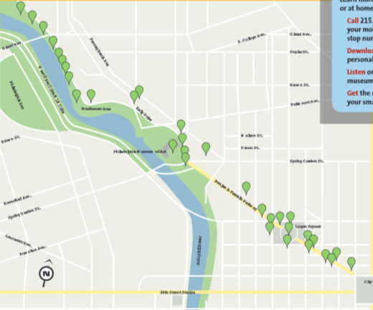


Help citizens better understand the park and all it has to offer.
Help citizens better understand the park and all it has to offer.
What park are we talking about when we say "Fairmount Park?" Is it one big park, every park in the city, or numerous smaller parks?
Don't think about the park as an island. Think about the park as a series of "zones" that connect to specific neighborhoods.
Improve how we provide citizens with the information they need about all the ways to enjoy themselves in the park
Create more welcoming entrances that encourage people to use the park
draft guideline #4
Notes:
What park are we talking about when we say "Fairmount Park?" Is it one big park, every park in the city, or numerous smaller parks?
Don't think about the park as an island. Think about the park as a series of "zones" that connect to specific neighborhoods.
Improve how we provide citizens with the information they need about all the ways to enjoy themselves in the park
Create more welcoming entrances that encourage people to use the park

Slide 15




Improve Fairmount Park for all residents, starting with near neighbors.
Improve Fairmount Park for all residents, starting with near neighbors.
Retain Fairmount Park's role as a park for both adjacent communities and people throughout the region
Find ways to improve how large events are conducted so that they minimize disruptions of neighborhood uses of the park
Place special emphasis on our youth and ways to provide education and employment opportunities to introduce them to the park. Make park improvements with existing residents in mind
Promote Fairmount Park's role as the hub of the regional trail network. Continue to promote and encourage a wide range of uses and activities that appeal to a variety of audiences
Give each park "zone" a community identity that will create a sense of pride and encourage neighbors to enjoy all the park's offerings
draft guideline #5
Notes:
Sister Cities – something that benefits both neighbors and city residents
Emphasize water and kids also!
Start with what benefits near neighbors, and it becomes an asset for all. But if we do not find a way for the park to serve its nearest communities, then it fails.
Access to Rowing and Paddling – trying to create more inclusive opportunities for all to enjoy the Schuylkill River. (Philadelphia City Rowing).
Retain Fairmount Park's role as a park for both adjacent communities and people throughout the region
Find ways to improve how large events are conducted so that they minimize disruptions of neighborhood uses of the park
Place special emphasis on our youth and ways to provide education and employment opportunities to introduce them to the park. Make park improvements with existing residents in mind
Promote Fairmount Park's role as the hub of the regional trail network. Continue to promote and encourage a wide range of uses and activities that appeal to a variety of audiences
Give each park "zone" a community identity that will create a sense of pride and encourage neighbors to enjoy all the park's offerings

Slide 16




Make the park safer and more accessible for people walking and biking; reduce the emphasis on people driving.
Make the park safer and more accessible for people walking and biking; reduce the emphasis on people driving.
Create safe crossings of the river drives and park roads for pedestrians and bicyclists throughout the park
Reduce the number of roads where appropriate
"It’s Fairmount Park, not Fairmount Parking" -- create a parking system in the park that doesn’t burden neighbors
draft guideline #6
Notes:
Create safe crossings of the river drives and park roads for pedestrians and bicyclists throughout the park
Reduce the character of the roads where appropriate
"It’s Fairmount Park, not Fairmount Parking" -- create a parking system in the park that doesn’t burden neighbors

Slide 17
Are we there yet?
What are we missing?
We want to hear from you.

Slide 18
CREATE a list of uses (past, present and future) that show how you would most like to use East and West Fairmount Park.
STRENGTHEN our draft guidelines so that they best represent the needs and interests of the community and guide our recommendations.
tonight’s charge

Slide 19
How do you currently use East and West Fairmount Park?
What else would you like to do there?
What gets in the way?
What parts of the park are accessible to you and your neighbors?
What would you do to make it more accessible to you and your neighbors?
Do the guidelines allow for the new activity you’d like to see in the park? Do they hinder these ideas at all?
process/questions

Slide 20
Listen to each other - it’s as important as talking
Everyone is encouraged to participate. Speak your mind freely, and invite others to speak as well
Ask clarifying questions. Help to develop one another’s ideas
If you disagree, explore that disagreement, don’t try to resolve it. Use it to try to understand each other
Everyone understand the talk is deliberative rather than argumentative.
Listen to each other - it’s as important as talking.
ground rules

Slide 21
  Next Steps
  Gather all public feedback
  Post it online and provide paper copies at community centers
  Report “what we heard” and ideas through community organizations
For status updates and other ideas: 215-746-3849 or praxis@design.upenn.edu
For project information and to monitor our progress, check out:
www.planphilly.com/eastandwestpark and http://www.gse.upenn.edu/pcel/programs/ppce.
thank you!

